Slide 1
Introduction to Julia
A programming language for scientific computing

Slide 2
Content
What is Julia?
Why Julia?
Benchmark Examples
Interesting language features
Live demo
Questions

Slide 3
What is Julia?
In a Nutshell:
Julia is a fast programming language, designed from the ground up for high performance.
Julia is dynamically typed, it feels like a scripting language and has great support for interactive use.
Julia is reproducible, having a built-in package manager and being available across a wide range of platforms.
Julia is Open Source – under the MIT license.

Slide 4
Why Julia? – The Two Language Problem
Develop code in an easy to use, dynamic language like Python or MATLAB
If code is performance sensitive, then rewrite your code in a faster language like C/C++ or Fortran.
Attempts have been made to make this easier, such as porting code like Linear Algebra to C and then calling from the slower language. (numpy for python)
Limited to what has already been ported over, what if that code doesn’t exist?

Slide 5
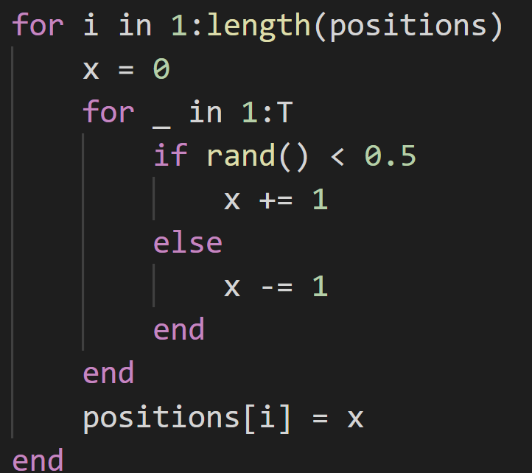
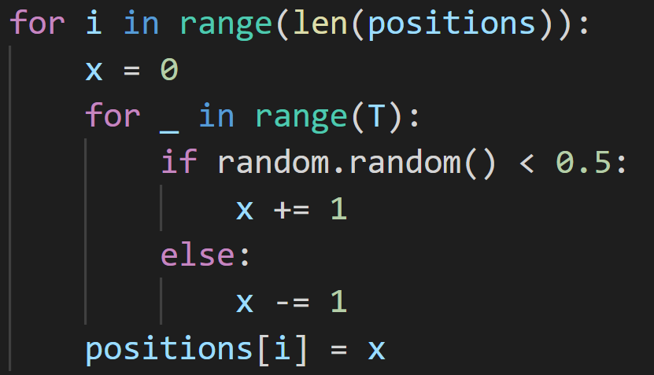


Python vs Julia – Random Walk benchmark
$$N=2^{10}$$
$$T=100$$
Julia:
Python:
$$N=2^{10}$$
$$T=100$$
8509.3 μs
313.5 μs
Julia is around 30 times faster here

Slide 6
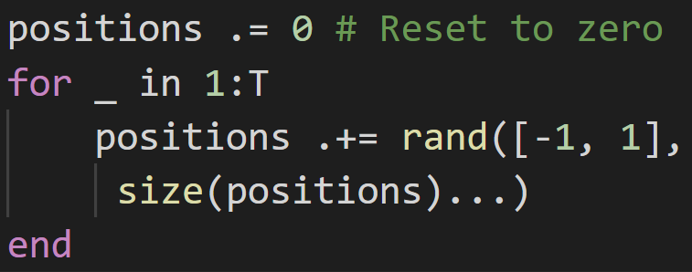
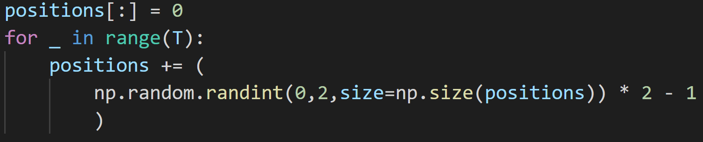
Python vs Julia – Random Walk w/ Arrays
$$N=2^{10}$$
$$T=100$$
378.7 μs
Julia:
1415.8 μs
Python:
Julia is only around 4x faster here, but numpy implementation could be better

Slide 7
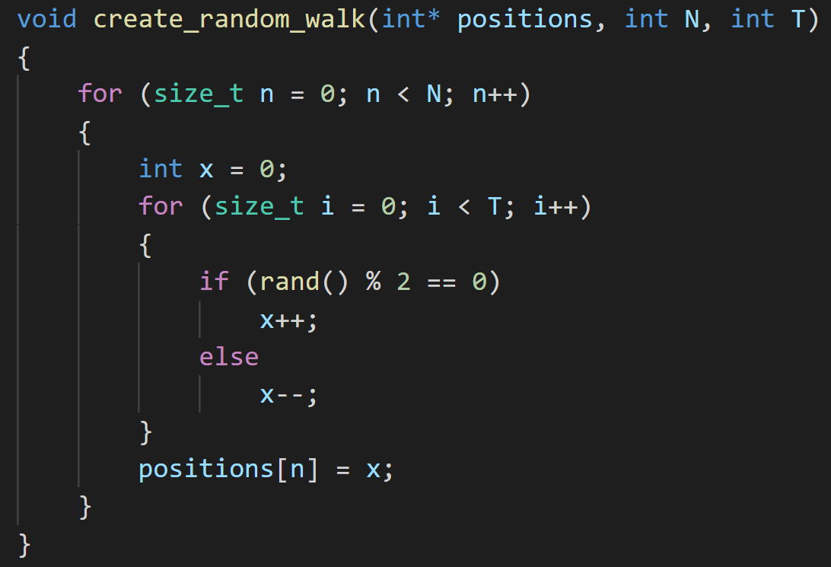
C++ vs Julia – Random Walk benchmark
$$N=2^{10}$$
$$T=100$$
Julia:
C/C++:
$$N=2^{10}$$
$$T=100$$
509 μs
313.5 μs
Julia is around 1.6 times faster here

Slide 8
Why is Julia fast?
Just-in-Time compiled, which specialises on the types of the variables.
Compiler tries to perform many optimisations, such as Single Instruction Multiple Data (SIMD) commands which most modern CPUs support.
Only fast if type stable!

Slide 9
So what?

Slide 10
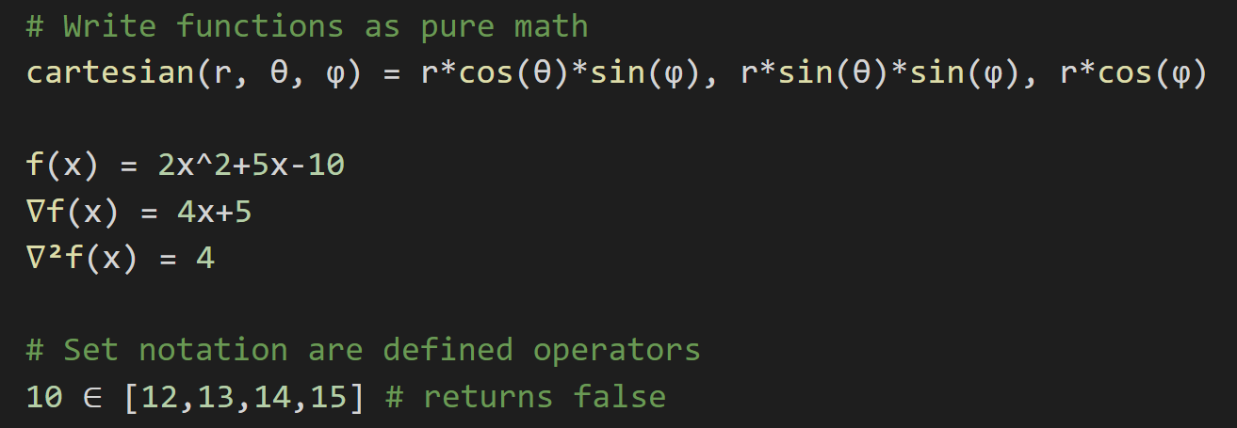
Interesting language features
Full support for Unicode:

Slide 11
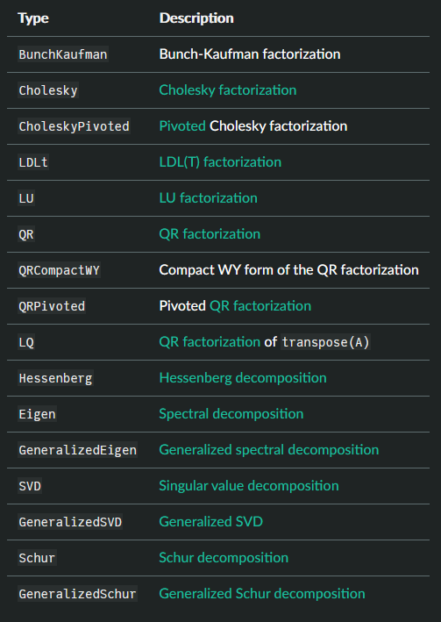
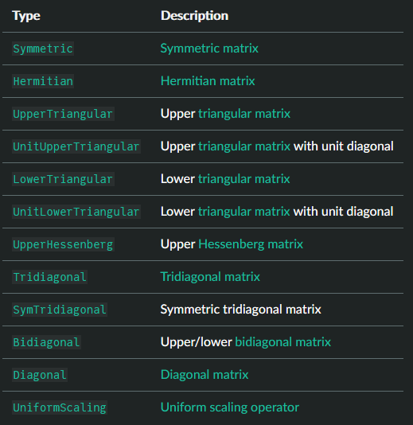
Interesting language features
Native support for linear algebra: (with choice of OpenBLAS or MKL)

Slide 12
Interesting language features
Metaprogramming macros – code that writes code
@simd macro on for loops tells the compiler to write out a for loop in a hardware vectorised format
Threads.@threads will parallelise your code across multiple threads trivially
@btime (from BenchmarkTools.jl) allows you to easily benchmark code, without any boilerplate
Many code introspection tools like @code_warntype, @code_llvm and @code_native to help write performant code.

Slide 13
Interesting language features – LIVE DEMO
Great support for parallelising your code across multiple cores or an entire cluster
Language interop – call other languages straight from Julia – have access to the entire Python ecosystem, no need for a wrapper!
Great support for using GPUs!

Slide 14
Downsides of Julia
Index of arrays start from 1, not 0.
Need to learn type system and multiple dispatch
Have to wait for compilation – high latency, especially suffers in plotting with the TFFP (time for first plot) problem
No classes! Only functions and data structures
Can take a bit of practice to get the best performance
Smaller community – it might be difficult to find help

Slide 15
Best resources to start
The Julia documentation! https://docs.julialang.org/en/v1/manual/getting-started/
Computational Thinking | MIT Course (w/ 3Blue1Brown): https://www.youtube.com/playlist?list=PLP8iPy9hna6Q2Kr16aWPOKE0dz9OnsnIJ
Parallel Computing and Scientific Machine Learning | MIT: https://github.com/mitmath/18337
Julia high performance (book): https://nusearch.nottingham.ac.uk/permalink/f/t1e4u0/TN_cdi_askewsholts_vlebooks_9781788292306

Slide 16
Questions?

Slide 17
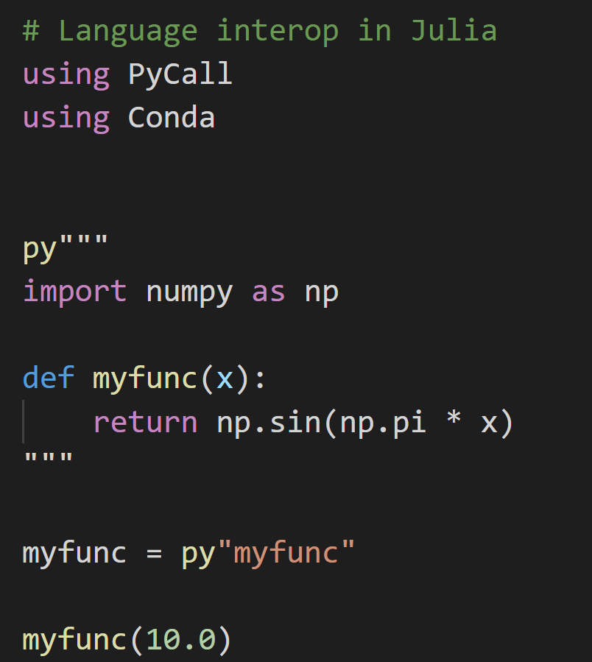
Interop – Calling other languages from Julia
Pure python code

Slide 18
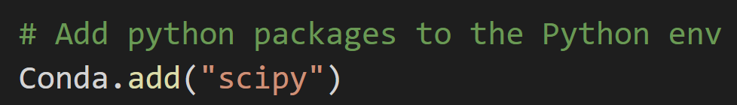
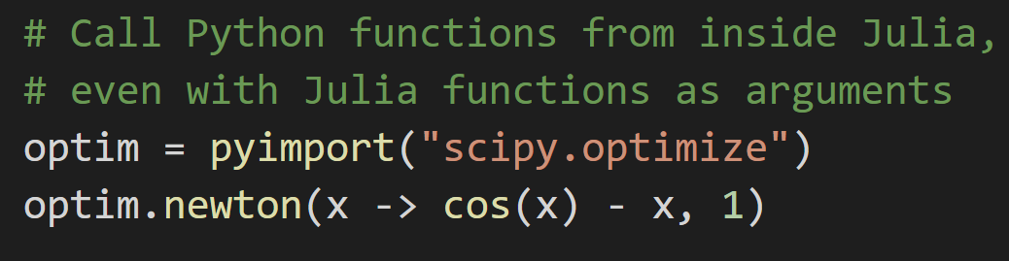
Interop – Calling other languages from Julia

Slide 19
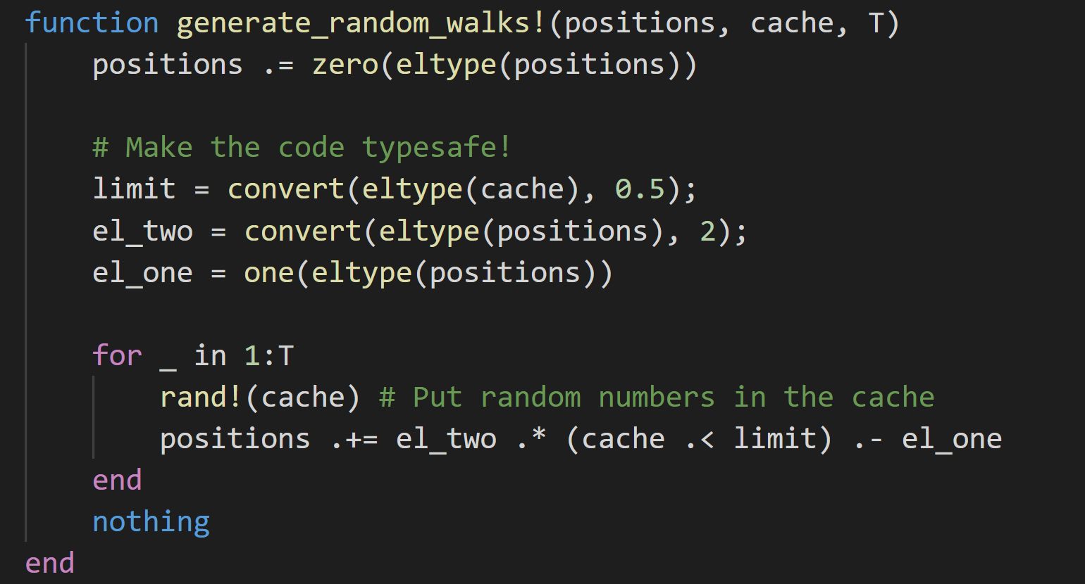
Array version of Monte Carlo simulation

Slide 20
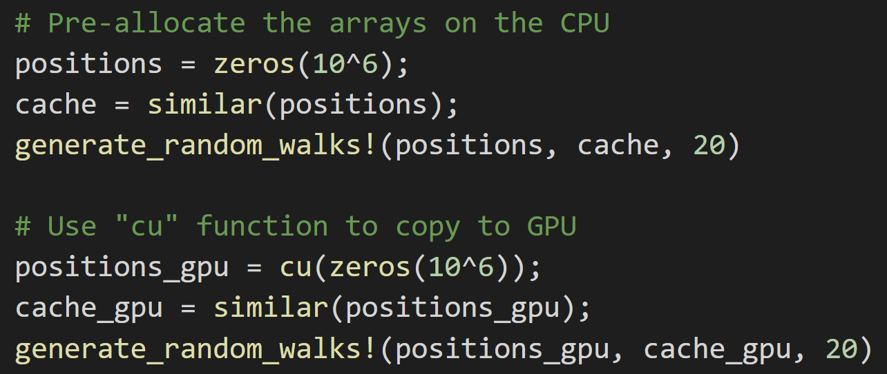
Using CPU vs GPU

Slide 21
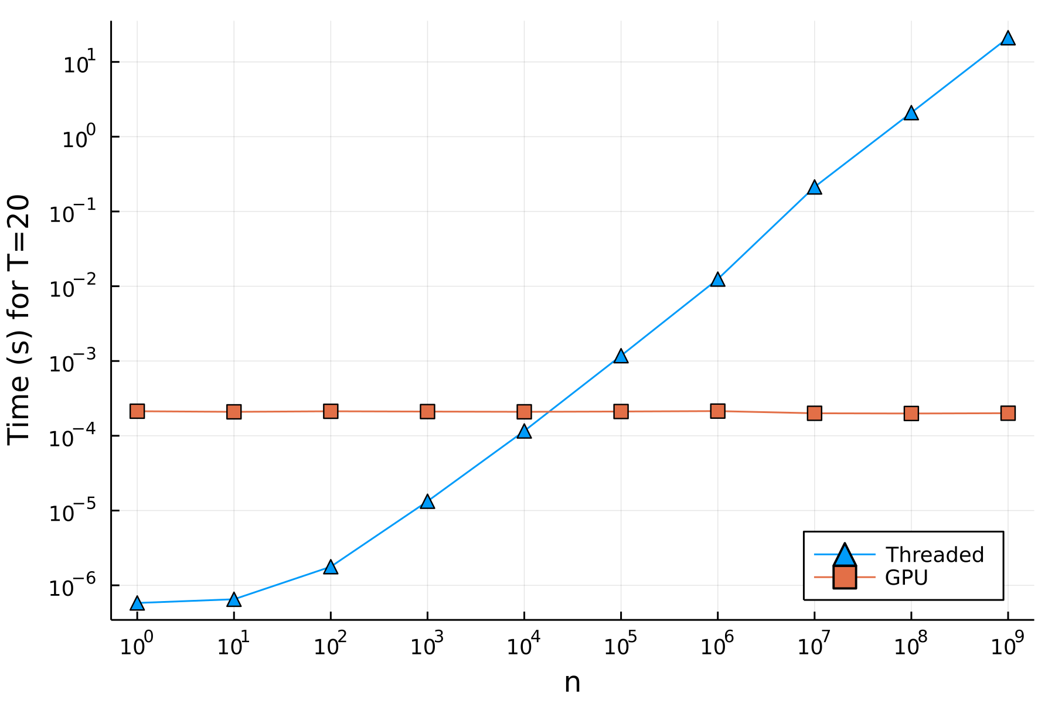
Using GPUs for parallelism

Slide 22
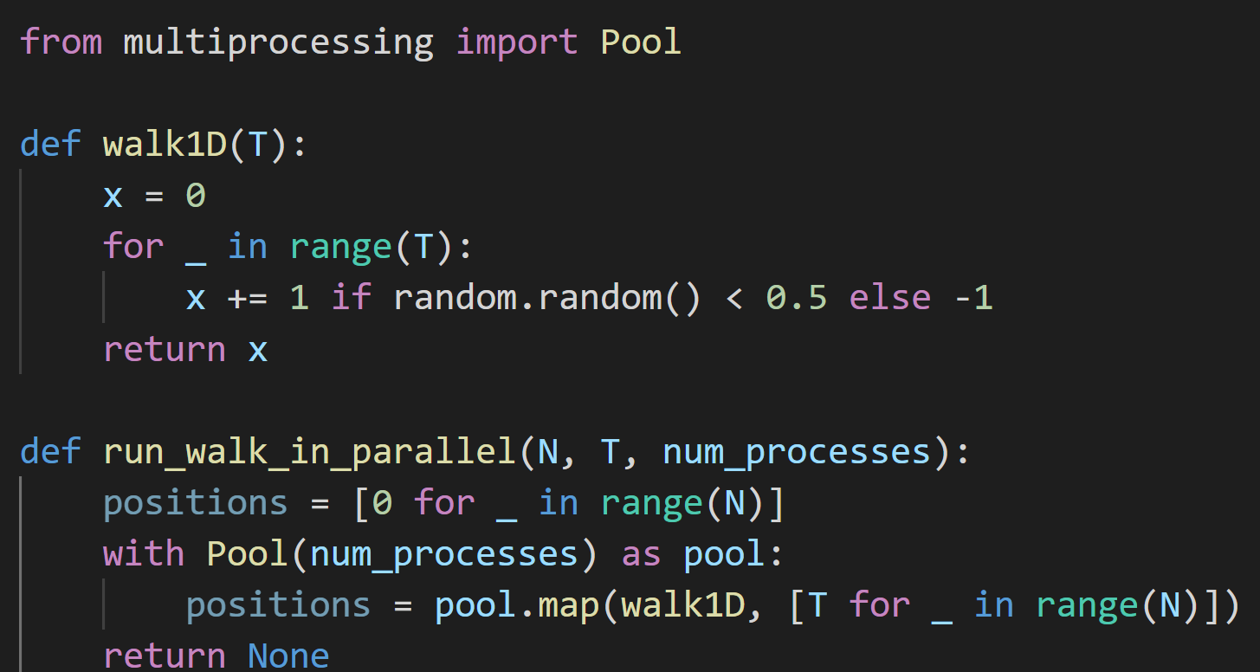

Python vs Julia – Random Walk in Parallel
Python:
$$N=2^{20}$$
$$T=100$$
1030ms

Slide 23
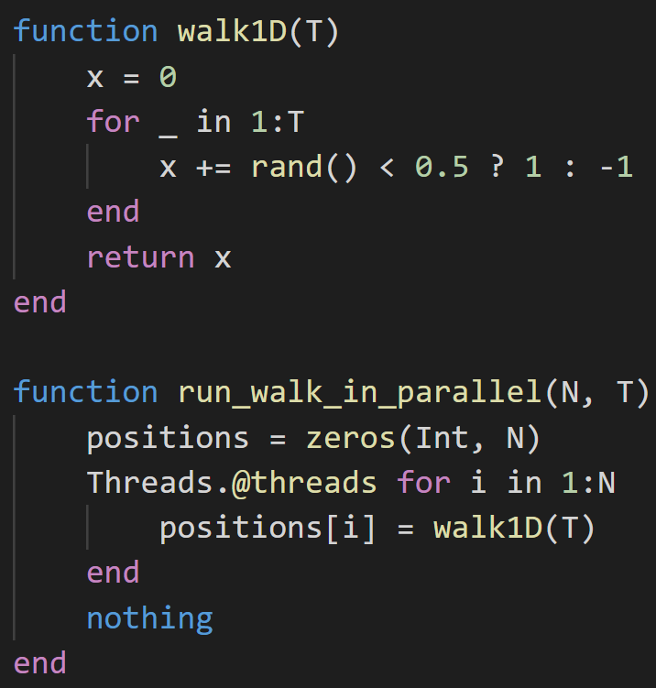

Python vs Julia – Random Walk in Parallel
Julia:
~40 times faster than in Python.
$$N=2^{20}$$
$$T=100$$
25.16ms

Slide 24
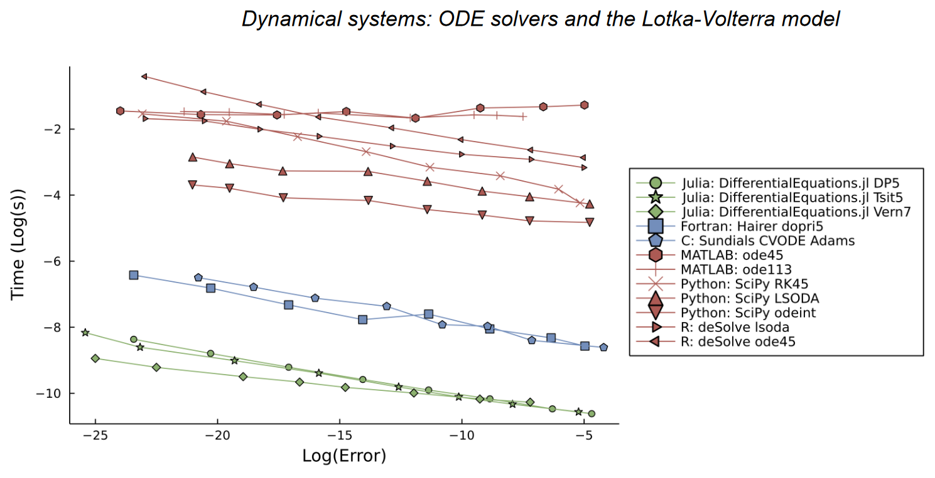
Performance in DifferentialEquations.jl
Julia for Biologists: https://arxiv.org/abs/2109.09973

